Slide 1
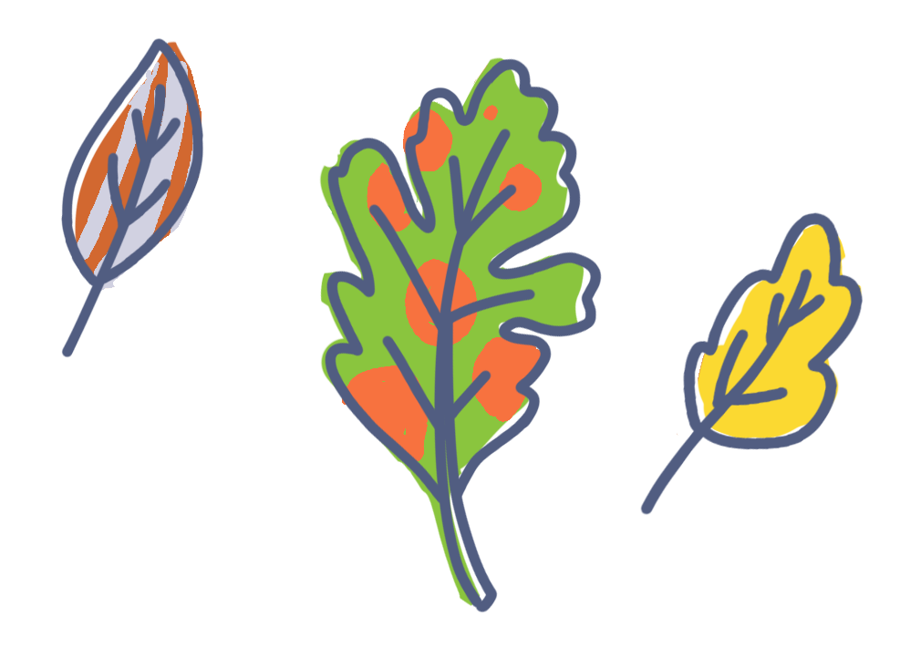
Crosscutting Concepts
Patterns

Slide 2
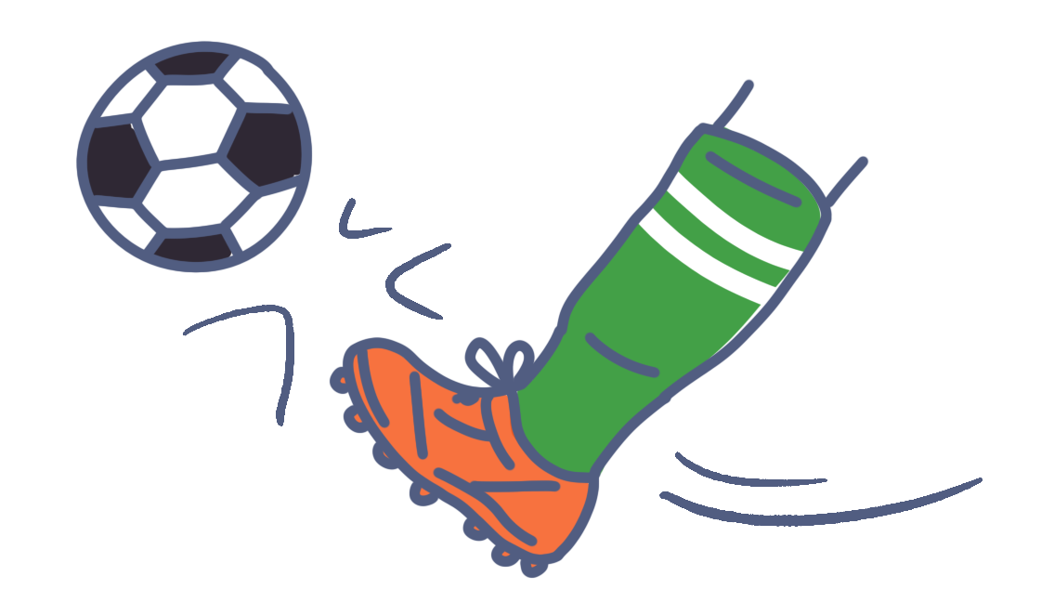
Crosscutting Concepts
Cause and Effect

Slide 3
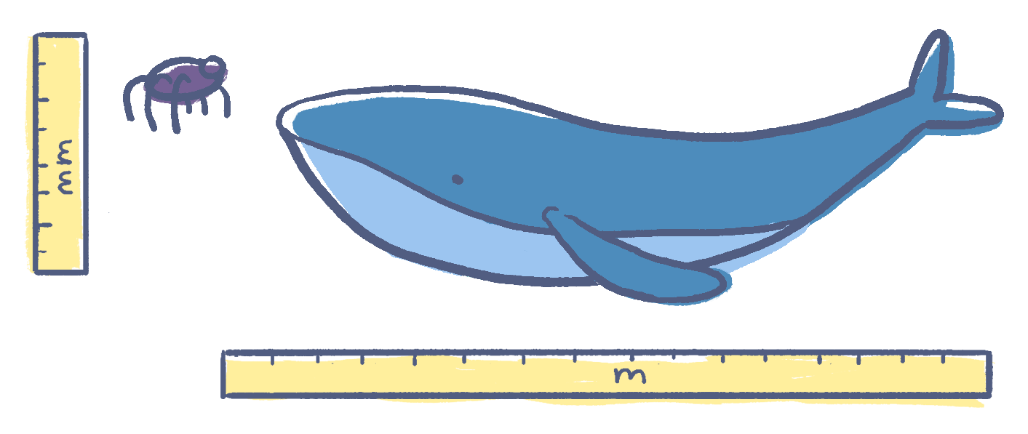
Crosscutting Concepts
Scale, Proportion, and Quantity

Slide 4
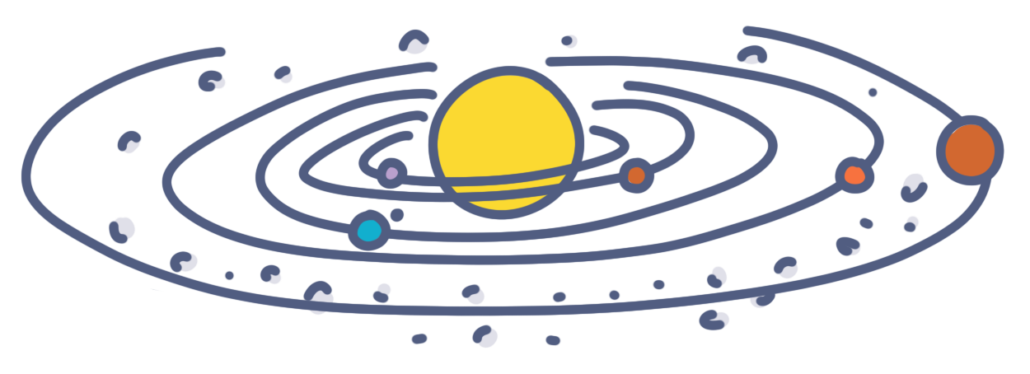
Crosscutting Concepts
Systems and System Models

Slide 5
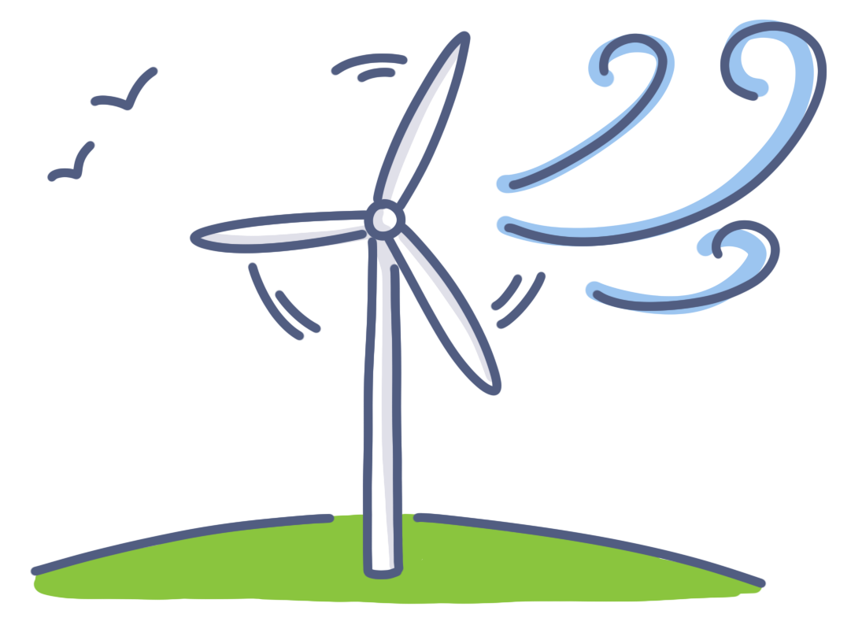
Crosscutting Concepts
Energy and Matter

Slide 6
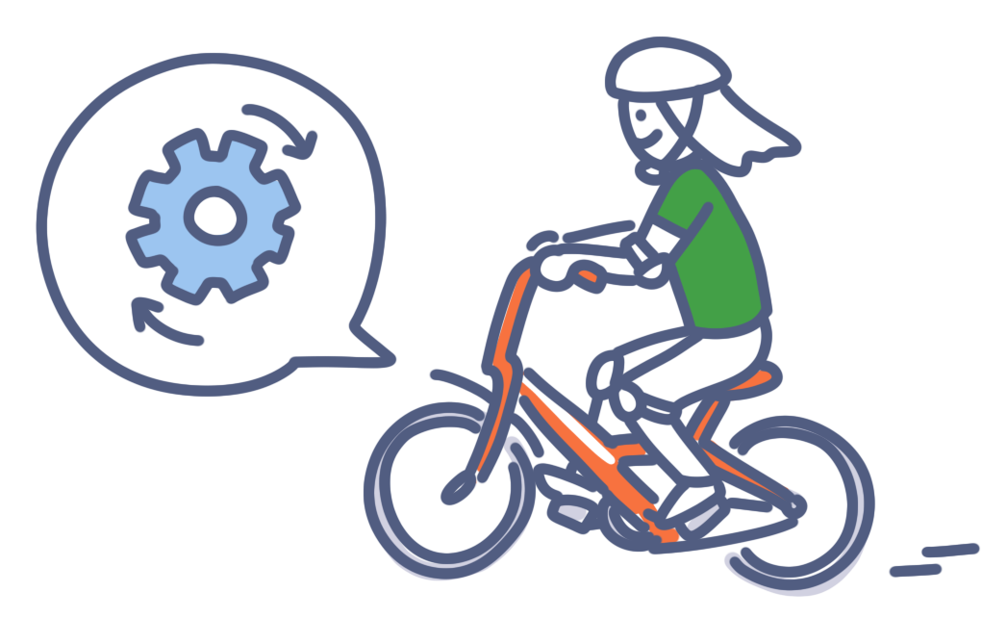
Crosscutting Concepts
Structure and Function

Slide 7
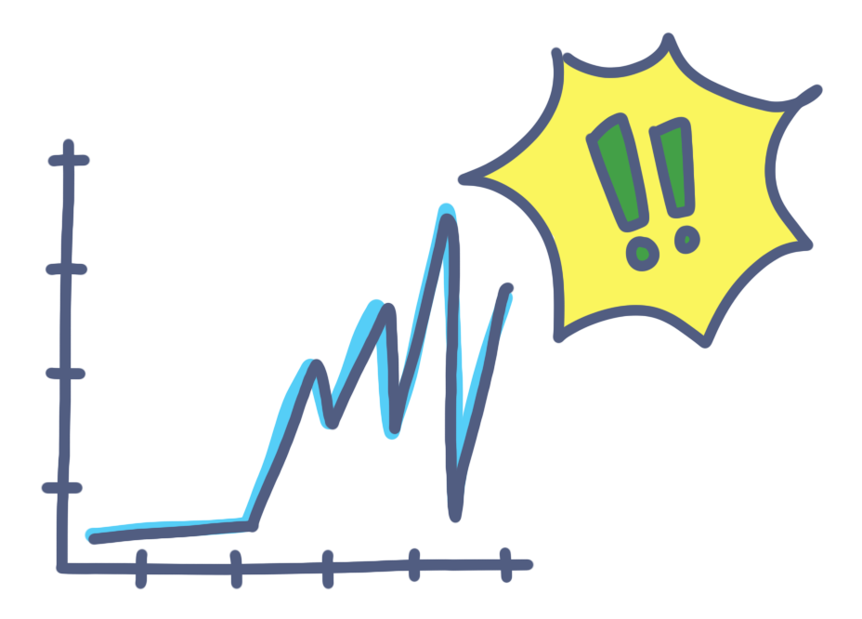
Crosscutting Concepts
Stability and Change

