Slide 1
Science and Engineering Practices
Asking Questions and Defining Problems

Slide 2
Science and Engineering Practices
Developing and Using Models

Slide 3
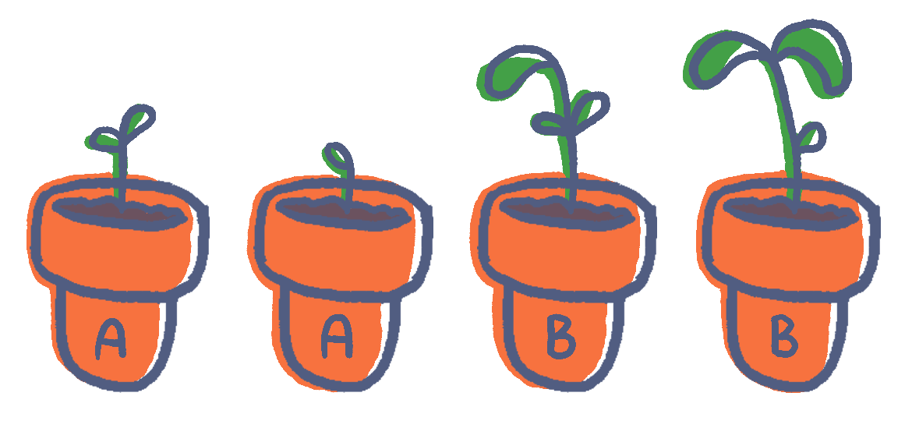
Science and Engineering Practices
Planning and Carrying Out Investigations

Slide 4
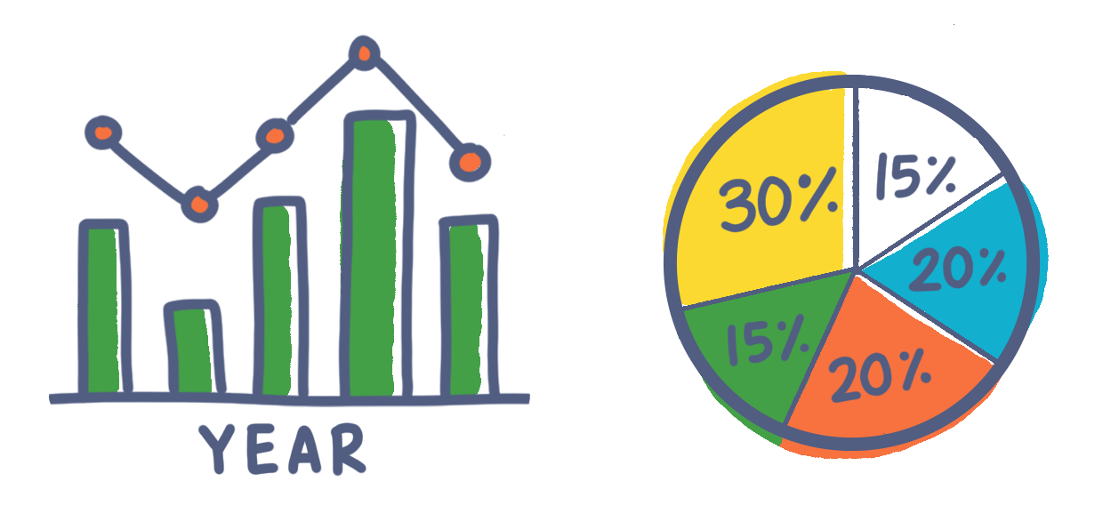
Science and Engineering Practices
Analyzing and Interpreting Data

Slide 5
Science and Engineering Practices
Using Mathematics and Computational Thinking

Slide 6
Science and Engineering Practices
Constructing Explanations and Designing Solutions

Slide 7
Science and Engineering Practices
Engaging in Argument from Evidence

Slide 8
Science and Engineering Practices
Obtaining, Evaluating, and Communicating Information

